Slide 1

TUTORIAL OF MATRIX OPERATIONS
By
Batch –C15
K. SAI LIKITHA (21JG1A1230) V. MEGHANA (21JG1A1259)
CH. HEMALATHA (21JG1A1212) R. RUKMINI (21JG1A1249)
Under the esteemed guidance of
R. SRIDEVI
Assistant Professor
IT Department
Department Of Information Technology
GAYATRIVIDYAPARISHADCOLLEGEOFENGINEERINGFORWOMEN
[Approved by AICTE NEW DELHI, Affiliated to JNTUK Kakinada]
[Accredited by National Board of Accreditation (NBA) for B.Tech. CSE, ECE & IT – Valid from 2019-20 to 2021-22]
Kommadi, Madhurawada, Visakhapatnam–530048
2022–2023

Slide 2
AIM:
The purpose of this project is to develop a software system that provides a tutorial for matrix operations . The tutorial should cover the fundamental operations of matrix addition, multiplication, determinant, and inverse, as well as support for sparse matrices. The system should be user-friendly and accessible to users with a range of technical abilities, and should include interactive examples and exercises to reinforce understanding. The goal of the system is to provide an effective and engaging way for users to learn about matrix operations, with the potential to be used in educational settings or as a self-learning tool . The tutorial should cover the fundamental concepts of matrix operations and provide step-by-step instructions on how to perform these operations using appropriate algorithms. Additionally, the software should include features that allow users to check their answers and receive feedback on their performance. ​
The goal of this software is to provide an effective learning tool for individuals who are new to matrix operations or wish to improve their skills in this area.​

Slide 3
Types of Matrix Operations:
Addition of matrices
Multiplication of matrices
Determinant of matrices
Inverse of matrices

Slide 4
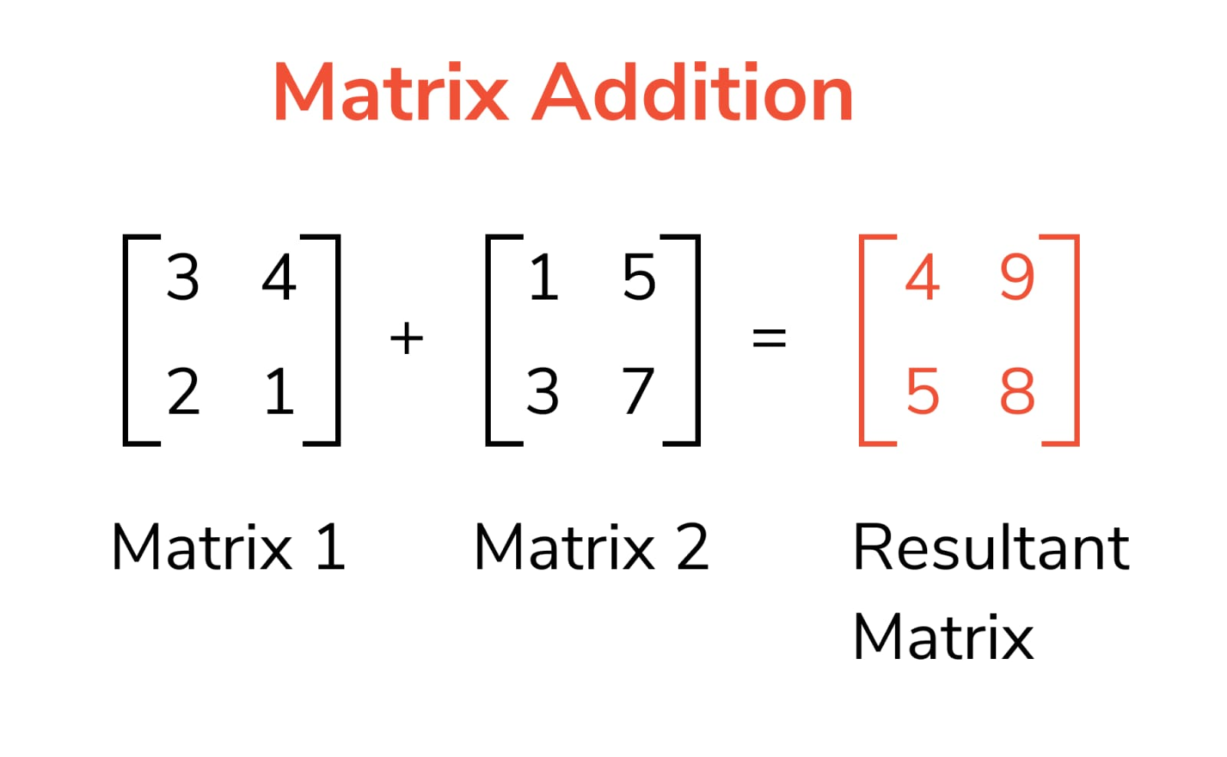
Addition of matrices
Addition of matrix is the basic operation performed, to add two or more matrices. Matrix addition is possible only if the order of the given matrices are the same. By order we mean, the number of rows and columns are the same for the matrices. Hence, we can add the corresponding elements of the matrices. But if the order is different then matrix addition is not possible. Suppose A = [aij]mxn and B = [bij]mxn are two matrices of order m x n, then the addition of A and B is given by;
A + B = [aij] + [bij] = [aij + bij]

Slide 5
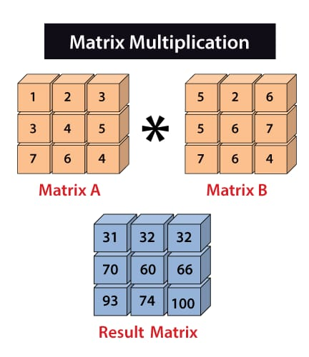
Multiplication of matrices
To perform multiplication of two matrices, we should make sure that the number of columns in the 1st matrix is equal to the rows in the 2nd matrix. Therefore, the resulting matrix product will have a number of rows of the 1st matrix and a number of columns of the 2nd matrix.

Slide 6
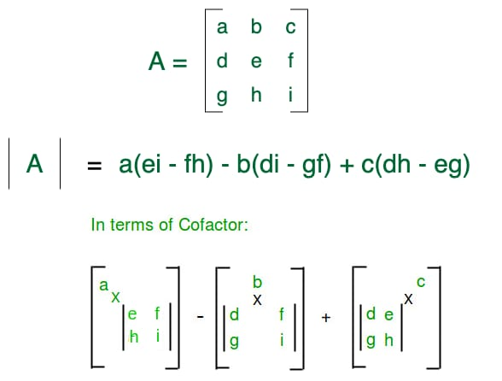
Determinant of matrices
The determinant of a matrix is the scalar value or number calculated using a square matrix. The square matrix could be 2×2, 3×3, 4×4, or any type, such as n × n, where the number of column and rows are equal. If S is the set of square matrices, R is the set of numbers (real or complex) and f : S → R is defined by f (A) = k, where A ∈ S and k ∈ R, then f (A) is called the determinant of A.

Slide 7
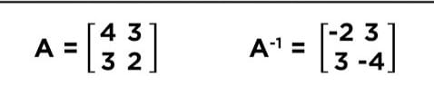
Inverse of matrix
If A is a non-singular square matrix, there is an existence of n x n matrix A-1, which is called the inverse matrix of A such that it satisfies the property:AA-1 = A-1A = I, where I is the Identity matrixThe identity matrix for the 2 x 2 matrix is given byidentity matrix 2 x 2

Slide 8
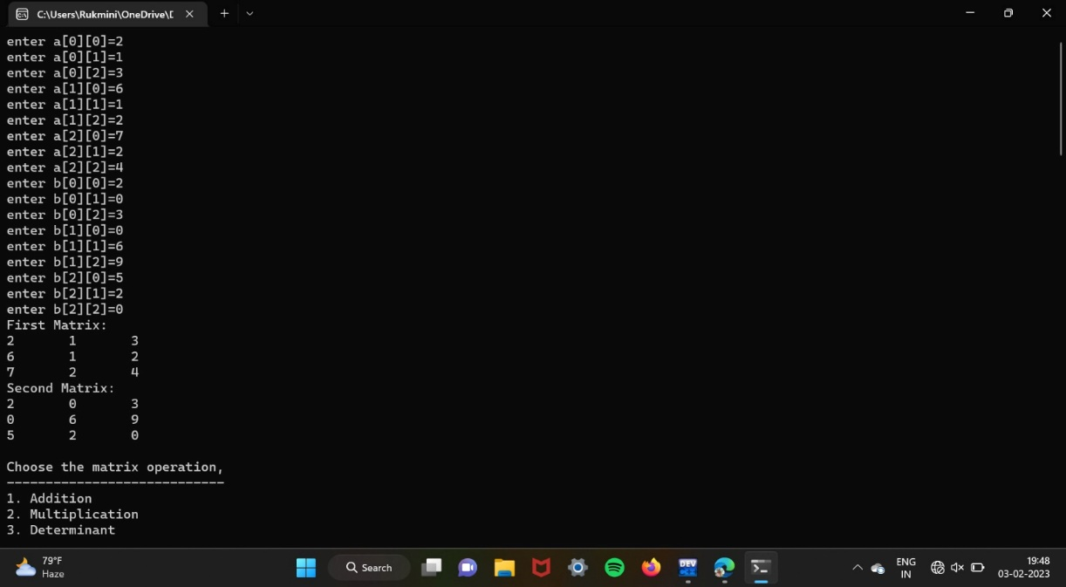
RELATED WORK (in C):
Output Screens:

Slide 9
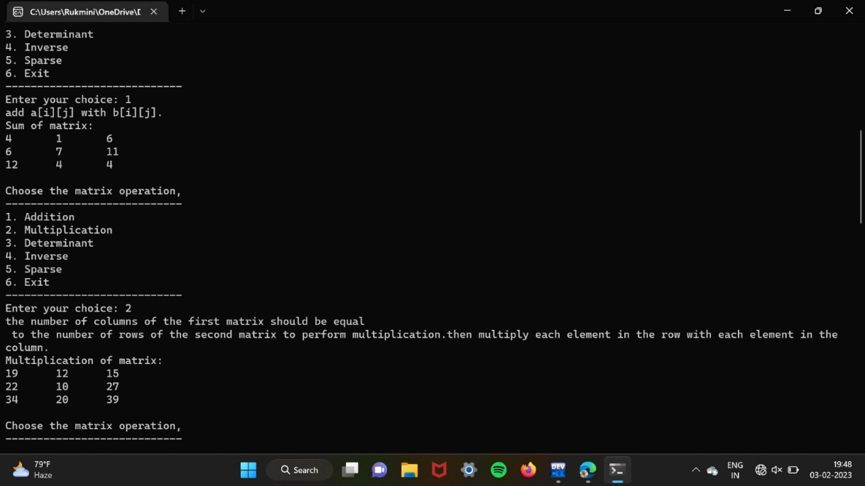
Addition and Multiplication:

Slide 10
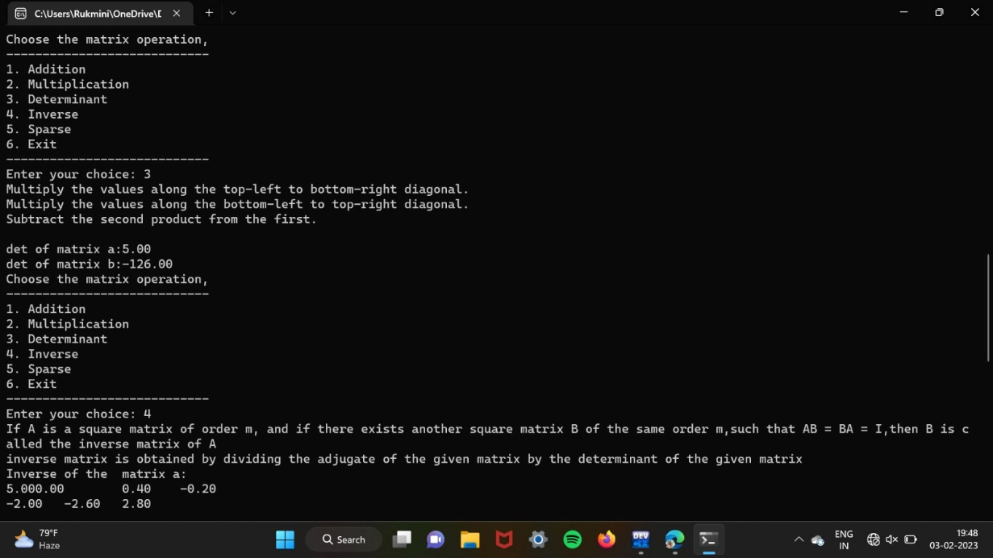
Determinant:

Slide 11
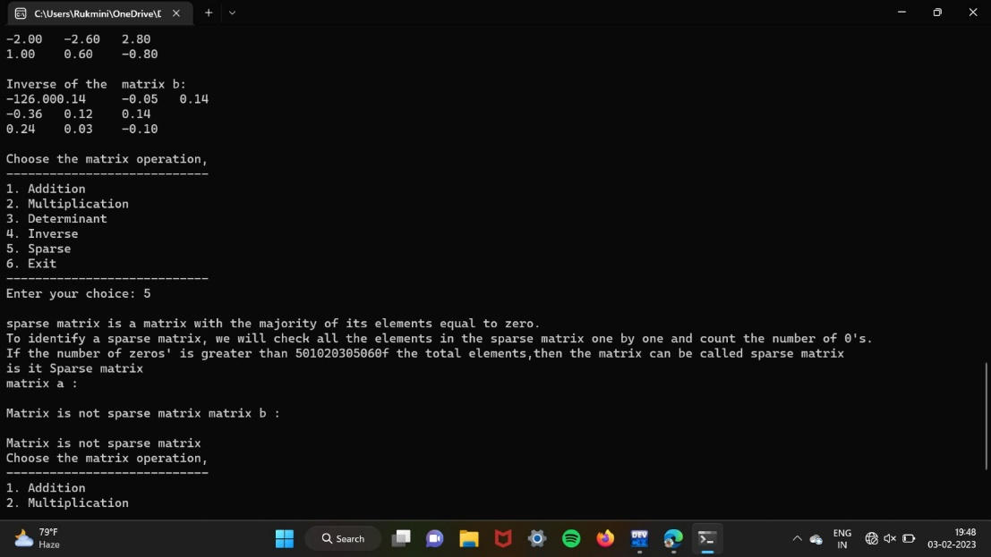
Sparse:

Slide 12
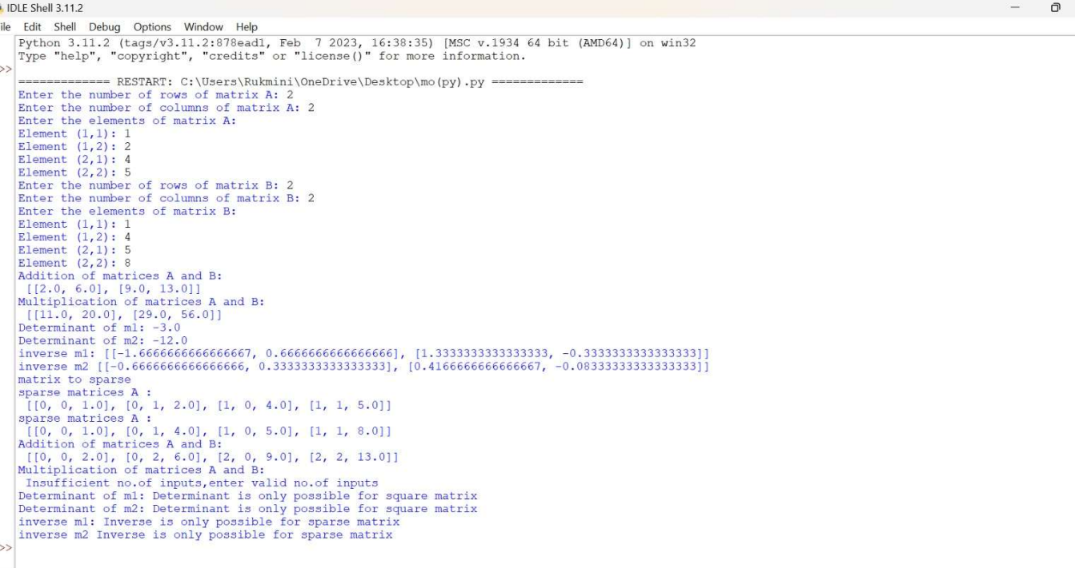
Related work (in Python):
Output Screens:
1.

Slide 13
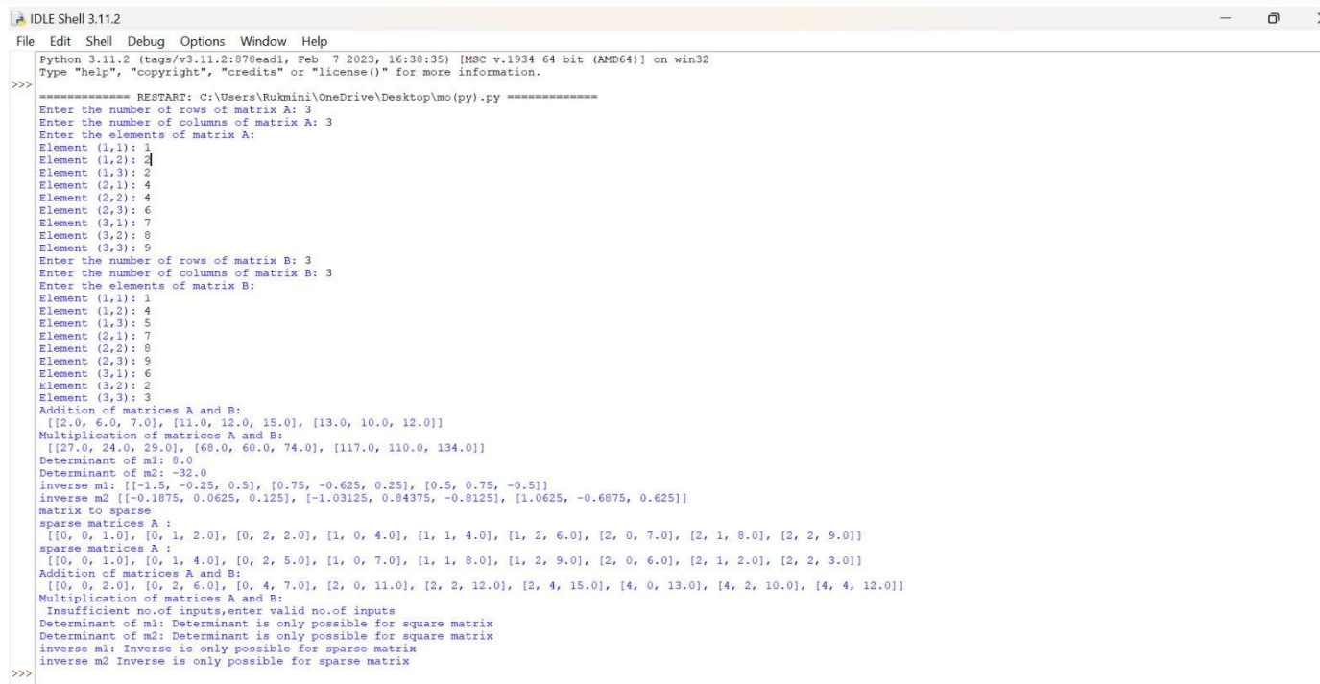
2.

Slide 14
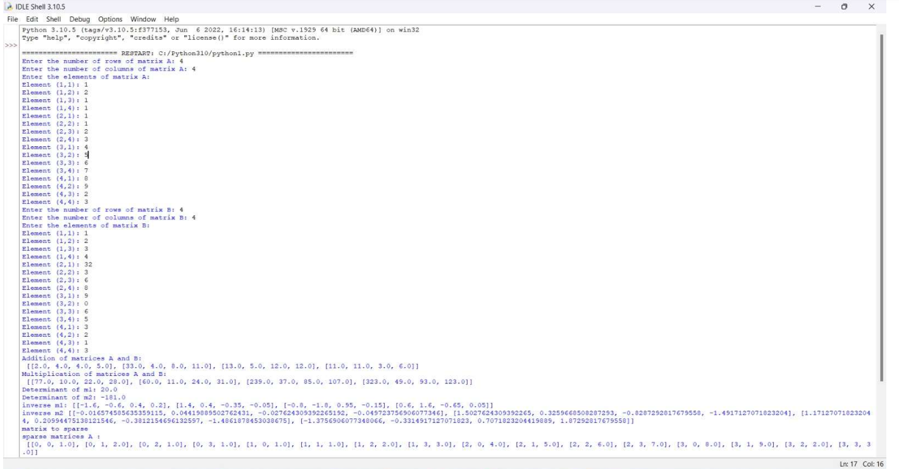
3.

Slide 15
Conclusion:
By this we can concluded that we can perform Addition, Multiplication, Determinant, Inverse and along Sparse matrix in Matrix Operation. And this is done in both c and python. In this tutorial for matrix operations we can observe that matrix operations include the arithmetic operations of addition, determinant, multiplication of matrices. Also, we can find the transpose and inverse of a matrix, which can also be included as operations on matrices. The matrix operations help in combining two or more matrices into a single matrix. The matrix operations help us to combine two of more matrices, to form a single matrix. The arithmetic operations of addition, determinant, multiplication can also be performed on matrices. Further sometimes matrix operations can change a matrix itself Overall with proper testing and potential feature additions, the code can be a useful and reliable tool for performing matrix operations on addition,multiplication,determinant,inverse including sparse matrix.

Slide 16
References:
Here are some useful references to learn about the concepts and techniques used in the code: Geeks for Geeks: https://www.geeksforgeeks.org/c-programming-language/ GFG (geeks for geeks): https://www.geeksforgeeks.org/java/ W3schools: https://www.w3schools.com/java/ Tutorials Point: https://www.tutorialspoint.com/cprogramming/index.htm Codecademy: https://www.codecademy.com/ https://www.python.org/ These resources can be helpful for further understanding of the code and the best practices for developing and testing in our projects.

Slide 17
THANK YOU

